Slide 1
Unit I
OBJECT ORIENTED METHODOLOGIES, UML

Slide 2
Content
Views of Software Developments
Some of the object Oriented Methodology
Unified Approach
Unified Modeling Language

Slide 3
Traditional system development methodology
Our development methodology comprises seven phases:
Define the Project’s Requirements
Create the Proposal
Develop and Approve the Functional Specifications
Develop the Software and Conduct the Alpha Release(develop and give review to client called alpha release)
Test for Quality Assurance and Conduct the Beta Release(final debugging and additional testing in beta release)
Conduct the Final Release
Make Enhancements and Offer Ongoing Support

Slide 4
Object oriented methodology
In 1980s ,many methodologist were wondering how analysis and design methods and processes would fit into the world.
Some of the oo methodology is as follows:
1986:-Booch developed the OO design concept called Booch methodology.
1987:-Sally and Steve created the recursive design approach.
1989:-Beck and Cunningham produced class responsibility collaboration card.
1989:-Wirfs-Brock,Wilkerson,and wiener came up with responsibility driven design.
1991:-Jim Rumbaugh led a team at the research lab of General Electric to develop the object modelling technique.

Slide 5
Object oriented analysis and design
Object-oriented analysis and design (OOAD) is a popular technical approach for
• analyzing,
• designing an application, system, or business
• by applying the object oriented paradigm and
• visual modeling throughout the development life cycles for better communication and product quality.

Slide 6
Object oriented analysis and design
Object-oriented programming (OOP) is a method
• based on the concept of “objects",
• which are data structures that contain data,
• in the form of fields,
• often known as attributes;
• and code, in the form of procedures,
• often known as methods.

Slide 7
Object oriented analysis and design
What is OOAD?
- Object-oriented analysis and design (OOAD) is a software engineering approach that models a system as a group of interacting objects .
Analysis
— understanding, finding and describing concepts in the problem domain.
Design
— understanding and defining software solution/objects that represent the analysis concepts and will eventually be implemented in code.
OOAD
- A software development approach that emphasizes a logical solution based on objects.

Slide 8
ORTHOGONAL VIEWS OF THE SOFTWARE
Two Approaches,
Traditional Approach
Objected-Oriented Approach
TRADITIONAL APPROACH :
• Collection of programs or functions.
• A system that is designed for performing certain actions.
• Algorithms + Data Structures = Programs.
• Software Development Models (Waterfall, Spiral, Incremental, etc..)

Slide 9
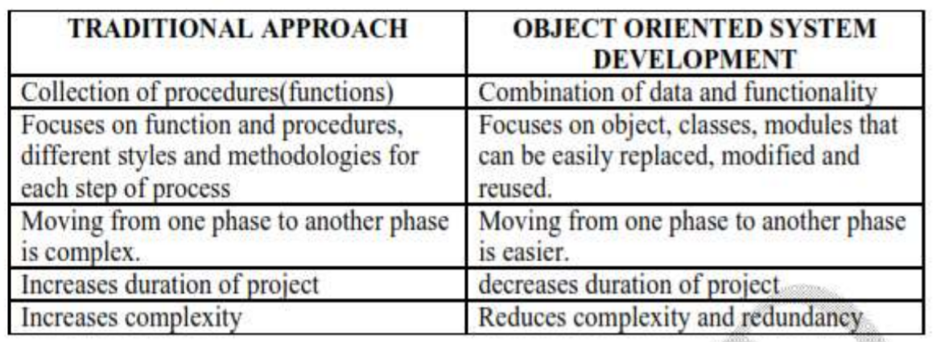
Difference between Traditional and Object Oriented Approach

Slide 10
BENEFITS OF OBJECT ORIENTATION
Faster development,
Reusability,
Increased quality
Modeling the real world and provides us with the stronger equivalence of the real world‘s entities (objects).
Raising the level of abstraction to the point where application can be implemented in the same terms as they are described.

Slide 11
WHY OBJECT ORIENTATION?
OO Methods enables to develop set of objects that work together
It adapts to
• Changing requirements
• Easier to maintain
• More robust
• Promote greater design
• Code reuse

Slide 12
WHY OBJECT ORIENTATION?
Others
• Higher level of abstraction
• Seamless transition among different phases of software development.
• Encouragement of good programming technique.
• Promotion of reusability

Slide 13
OVERVIEW OF UNIFIED APPROACH
The unified approach (UA) is a methodology for software development.
Booch, Rumbaugh, Jacobson methodologies gives the best practices, processes and guidelines for OO oriented software development.
Combines with the object management groups in unified modelling language.
UA utilizes the unified modeling language (UML) which is a set of notations and conventions used to describe and model an application.

Slide 14
OVERVIEW OF UNIFIED APPROACH
Layered Architecture
• UA uses layered architecture to develop applications.
• Creates object that represent elements to the user through interface or physically stored in database.
• The layered approach consists of user interface, business, access layers.
• This approach reduces the interdependence of the user interface, database access and business control.
• More robust and flexible system.

Slide 15
OBJECT BASICS
Goals: The developer should
Define Objects and classes
Describe objects, methods, attributes and how objects respond to messages,
Define Polymorphism, Inheritance, data abstraction, encapsulation, and protocol,
Describe objects relationships,
Describe object persistence,

Slide 16
EXAMPLES OF OBJECT ORIENTED SYSTEMS
In OO system , “everything is object”.
A spreadsheet cell, bar chart, title in bar chart, report,
numbers, arrays, records, fields, files, forms, an invoice, etc.
A window object is responsible for things like opening, sizing, and closing itself.
A chart object is responsible for things like maintaining data and labels even for drawing itself.

Slide 17
WHAT IS AN OBJECT?
The term object was first formally utilized in the Simula language to simulate some aspect of reality.
Attributes or properties describe object‘s state (data) and methods (properties or functions) define its behavior.
An object is an entity.
• It knows things (has attributes)
• It does things (provides services or has methods

Slide 18
OBJECT’S ATTRIBUTES
Attributes represented by data type.
They describe objects states.
In the Car example the car’s attributes are:
color, manufacturer, cost, owner, model, etc.

Slide 19
OBJECT’S METHODS
Methods define objects behaviour and specify the way in which an Object’s data are manipulated.
In the Car example the car’s methods are: drive it, lock it, tow it, carry passenger in it.

Slide 20


Slide 21


Slide 22


Slide 23
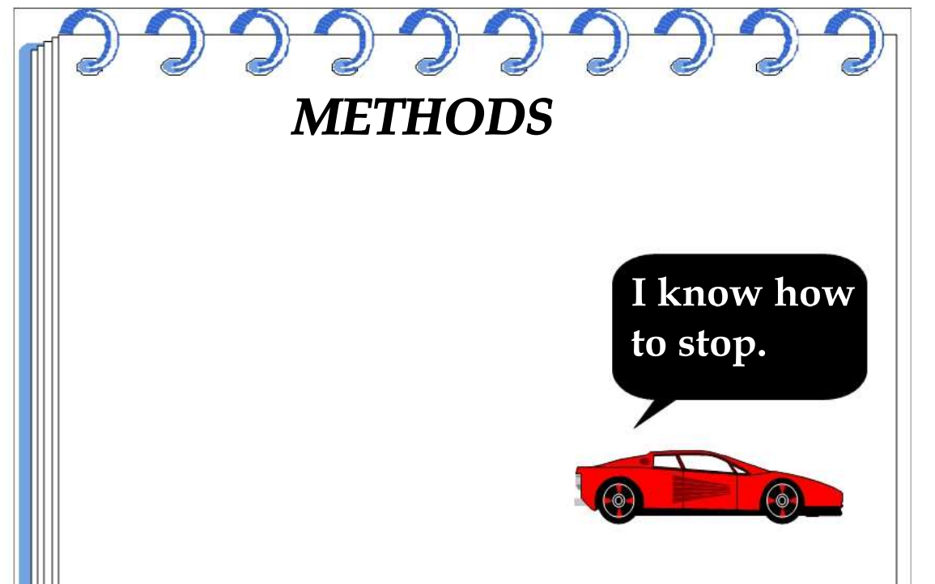

Slide 24
Object oriented design-Booch
It is a widely used object oriented method that helps you design your system using the object paradigm.
It covers the analysis and design phase of object oriented system.
Booch methodology have its large set of symbols.
Booch defines a lot of symbols to document almost every design decision.
You can’t use all symbols and diagrams of this method in our work.
You start with class and object diagram.

Slide 25
Car
colour
manufacturer
cost
Superclass
Inherits
Ford
Fig:Object modelling using Booch notation.The arrows represent specialization for example the class Taurus is subclass of the class Ford
Inherits
Escort
mustang
Taurus

Slide 26
Booch methodology
Booch method consists of the following diagrams:
Class diagrams
Object diagrams
State transition diagrams
Module diagrams
Process diagram
Interaction diagrams
Booch methodology prescribes a macro development process and micro development process.

Slide 27
The Macro development process
The macro process serves as a controlling framework for the micro process and can take weeks or even months.
The primary concern of the macro process is technical management of the system.
In the macro process , analysis and design are preserved.

Slide 28
The Macro development process
The macro development process consists of the following steps:
Conceptualization:
Here you establish the core requirements of the system.
Analysis and development of the model:
In this step you use the class to describe the roles and responsibilities of object.
Then you use object diagram to describe the desired behavior of the system.
Alternatively you can use interaction diagram to describe the behavior.

Slide 29
The Macro development process
Design or create the system architecture:
In this you use class diagram to decide what classes exist and how they relate to each other.
Next you use the object diagram to decide what mechanisms are used to regulate how objects are collaborate.
Then you use the module diagram to map out whare each class and object should be declared.
Finally you use the process diagram to determine to which processor to allocate a process.

Slide 30
The Macro development process
Evolution or implementation:
Successively refine the system through many interactions.
Maintenance:
Make localized changes to the system to add new requirements and eliminate bugs.

Slide 31
The micro development process
Each macro development process has its own micro development process.
The micro process is a description of the day to day activities by a single or small group of software developers.
In this analysis and design phases are not clearly defined.

Slide 32
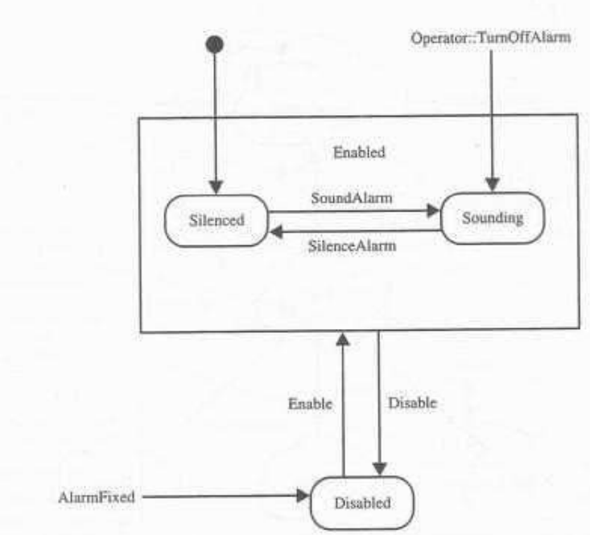
Fig: an alarm class state transition diagram with Booch notation.

Slide 33
The micro development process
The micro development process consist of the following steps:
Identify classes and object.
Identify class and object semantics.
Identify class and object relationship.
Identify class and object interfaces and implementation.

Slide 34
Rambaugh object modelling technique
Jim Rambaugh presented this technique.
This describes a method for the analysis ,design and implementation of a system using an object oriented technique.
Object modelling technique (OMT) is fast ,intuitive approach for identifying modelling all the objects making up a system.
Details such as class attributes,method,inheritance and association also can be expressed easily.

Slide 35
Rambaugh object modelling technique
Dynamic behavior of objects within a system can be described using OMT dynamic model.
This model let you specify detailed state transitions and their descriptions within a system.
Finally in OMT’s functional model ,process description and consumer-producer relationships can be expressed.

Slide 36
Rambaugh object modelling technique
OMT consist of four phases:
Analysis : The results are objects and dynamic and functional model.
System design: The results are a structure of the basic architecture of the system along with high level strategy decisions.
Object design: This phase produces a design document ,consisting of detailed object static ,dynamic ,and functional models.
Implementation :This activity produces reusable ,extendible and robust code.

Slide 37
Rambaugh object modelling technique
OMT separates modelling into three different parts:
An object model ,presented by the object model and data dictionary.
A dynamic model ,presented by the object model and the data dictionary.
A functional model , presented by data flow and constraints.

Slide 38
The object model
The object model describes the structure of objects in a system:their identity, relationships to other objects, attributes,and operations.
The object model is represented graphically with an object diagram.
What object diagram contains?
Object diagram contains classes interconnected by association lines.
Each class represents a set of individual objects.
The association lines establish relationships among classes.
Each association line represents a set of links from the objects of one class to objects of another class.

Slide 39
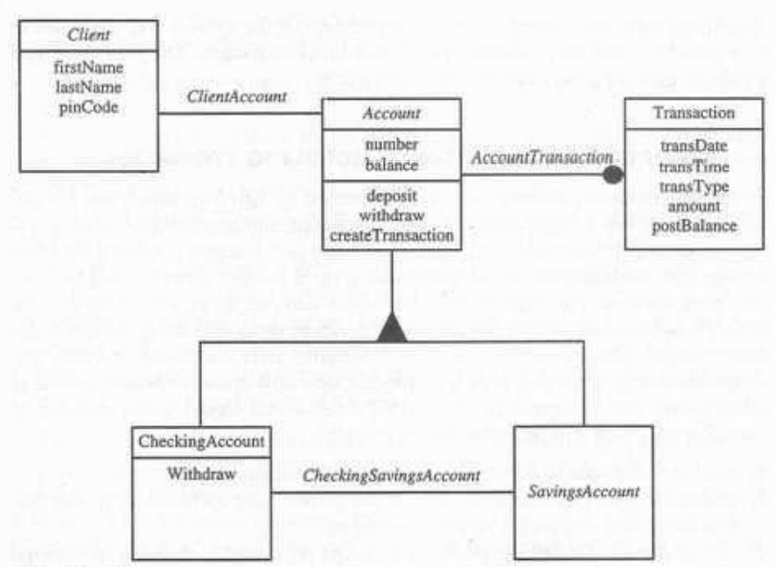
Boxes:classes
Filled triangle: Specialization
Lines:Association
Filled circle:one to many association
Fig : The OMT object model of a bank system

Slide 40
OMT dynamic model
OMT provides a detailed and comprehensive dynamic model ,in addition to letting you depict states, transitions, events and actions.
The OMT state transition diagram is a network of states and events.
Each state receives one or more events ,at which time it makes the transition to the next states.
The next state depends on current state as well as events.

Slide 41
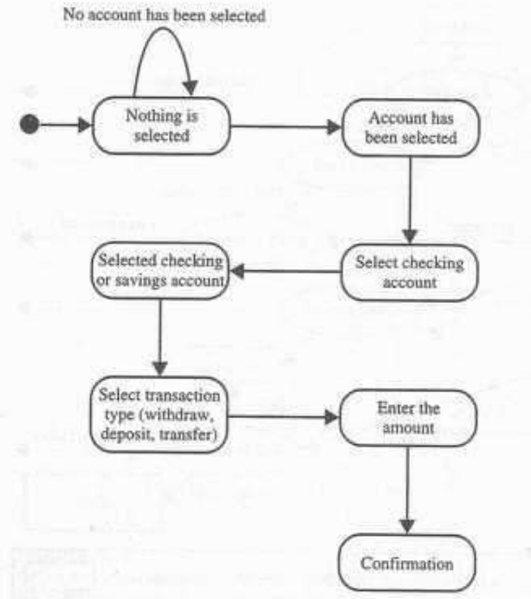
Fig: State transition diagram for the bank application user interface.
Round boxes: States
Arrows :Transition

Slide 42
OMT functional model
The OMT data flow diagram (DFD) shows the flow of data between different processes in a business.
DFD uses four primary symbols:
The process is any function being performed.
The data flow shows the direction of data element movement.
The data store is a location where data are stored.
An external entity is a source or destination of a data element.

Slide 43
Jacobson methodology
Jacobson methodologies cover the entire life cycle and stress traceability between the different phases ,both forward and backward.
This traceability enables reuse of analysis and design work.
Reuse of design reduce the development time.

Slide 44
Use cases
Use cases are scenarios for understanding system requirements.
Use case is an interaction between users and a system.
Use case model captures the goal of the user and the responsibility of the system to its user.

Slide 45
Use cases
In the requirement analysis ,the use cases are described as one of the following:
Nonformal text with no clear flow of events.
Text,easy to read but with a clear flow of events to follow.
Formal style using pseudo code.

Slide 46
Use cases
The use case description must contain :
How and when the use case begins and ends.
The interaction between the use case and its actors ,including when the interaction occurs and what is exchanged.
How and when is the case will need the data stored in the system or will store the data in the system.
Exception to the flow of events.
How and when concepts of the problem domain are handled.

Slide 47
Library
Checking out books
Getting an interlibrary loan
Doing research
Member
Reading books,newspaper
Purchasing supplies
Supplier

Slide 48
Use cases
Every single use case should describe one main flow of events.
The use case model employs extends and uses relationship.
The extends relationship is used when you have one use case that is similar to another use case but does a bit more.
The uses relationship reuses common behavior in different use cases.
Use cases could be viewed as concrete or abstract.
An abstract use case is not complete and has no actors that initiate it.

Slide 49
Object oriented software engineering:objectory
Object oriented software engineering(OOSE),also called objectory.
It is a method of object oriented development with the specific aim to fit the development of large ,real-time system.
The development process called use case driven development.
Use cases are involved in several phases of development including analysis,design ,validation and testing.

Slide 50
Object oriented software engineering:objectory
Objectory is built around several different models:
Use case model: It defines outside(actor) and inside(use cases)of the system’s behavior.
Domain object model: The objects of the real world are mapped into the domain object model.
Analysis object model: The analysis object model presents how the source code should be carried out and written.
Implementation model: The implementation model represents the implementation of the system.
Test model: The test model constitutes the test plans ,specification and reports.

Slide 51
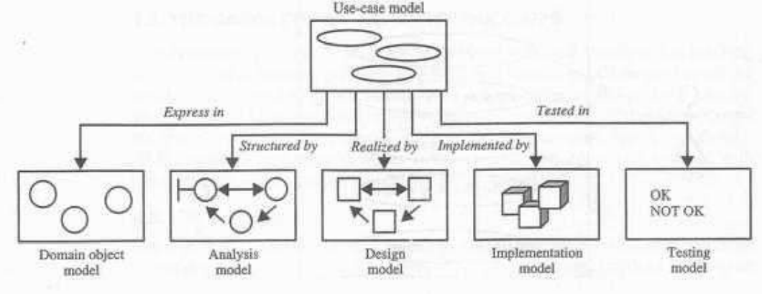
Fig: The uses case model is considered in every model and phase

Slide 52
Object oriented business engineering
It is object modelling at the enterprise level.
Analysis phase:
-This phase defines the system to be built in terms of the problem domain object model,requirements model and the analysis model.
-This process should not take into account the actual implementation environment.
-This reduces complexity and promotes maintainability over the life of system.

Slide 53
Object oriented business engineering
Design and implementation phase:
-This includes factors such as database management system(DBMS),distribution of process,constraints due to programming language,available component libraries and incorporation of graphical user interface tools.
-The analysis objects are translated into design objects that fit the current implementation environment.
Testing phase:
-Testing technique include unit testing , integration testing and system testing.

Slide 54
Unified approach
The unified approach establishes a unifying and unitary framework around their works by utilizing the UML.
The main motivation here is to combine the best practices,processes,methodologies and guidelines along with UML notations and diagrams for better understanding object oriented concepts and system development.

Slide 55
Unified approach
The unified approach to software development revolves around the following processes and concepts:
Use case driven development
Object oriented analysis
Object oriented design
Incremental development and prototyping
Continuous testing

Slide 56
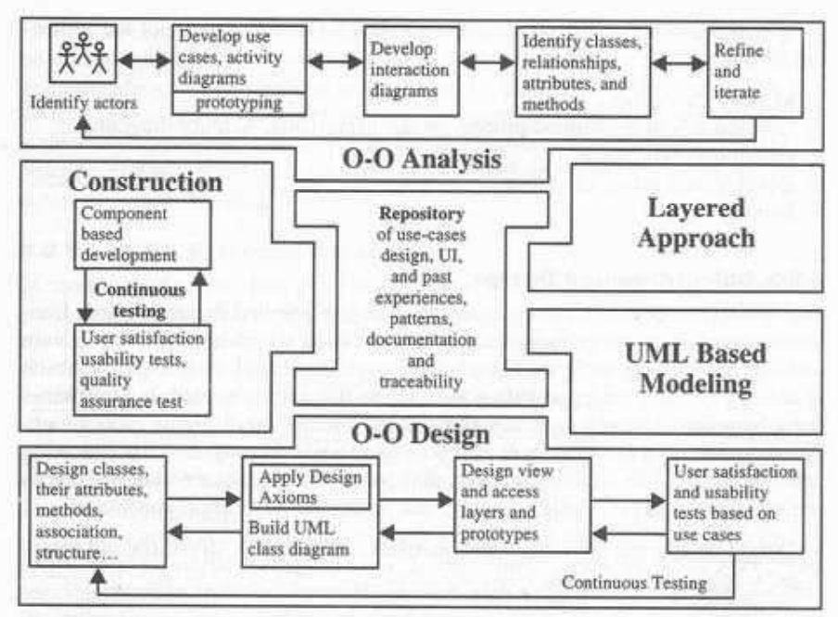
Fig: The processes and components of the unified approach

Slide 57
Object oriented analysis
The goal of object oriented analysis is to first understand the domain of the problem and the systems responsibilities.
This is accomplished by constructing several models of the system.
These models concentrate on describing what the system does rather than how it does.

Slide 58
Object oriented analysis
OOA process consists of the following steps:
Identify actors
Develop a simple business process model using UML activity diagram.
Develop the use case
Develop interaction diagrams
Identify classes

Slide 59
Object oriented design
OOD process consists of :
Designing classes ,their attributes,methods,associations,structures and protocols,apply design axioms.
Design the access layer
Design and prototype user interfaces.
User satisfaction and usability tests based on the usage/use case.
Iterate and refine design

Slide 60
Iterative development and continuous testing
You must iterate and reiterate until eventually ,you are satisfied with the system.
You should continue this refining cycle through development process until satisfied result will obtained.
The unified approach (UA) encourages the iteration of testing plans from day 1 of the project.
Usage scenarios can become test scenarios therefore use cases will drive the usability testing.
Usability testing is the process in which functionality of the system is measured.

Slide 61
Modelling based on UML
The UML is becoming the universal language for modelling system.
The UML has become the standard notation for object oriented modelling systems.
It is still under development.
The UA uses the UML to describe and model the analysis and design phases of system development.

Slide 62
Layered approach to software development
Most systems developed with client server application development environment which is two layer architecture: interface and data.
In two layered system,user interface screens are tied to the data through routines that sit directly behind the screens.
Example: routines execute when when you click on a button.
In the better approach uses three layer architecture.
This architecture consists of a view or user interface layer ,business layer and an access layer

Slide 63
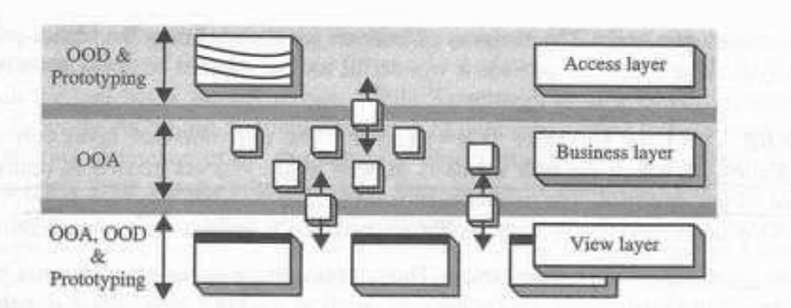
Fig: Layered approach of software architecture

Slide 64
Business layer
The business layer contains all the objects that represent the business.
The responsibilities of the business layer are straightforward: Model the objects of the business and how they interact to accomplish the business processes.
These objects should not be responsible for the following :
Displaying details: Business objects should have no special knowledge of how they are being displayed and by whom.
Data access details: Business objects also should have no special knowledge of where they come from.

Slide 65
The user interface layer
It consists of objects with which the user interacts as well as the objects needed to manage or control the interface.
The user interface layer is also called view layer.
This layer is typically responsible for two major aspects of application:
Responding to user interaction
Displaying business objects

Slide 66
Access layer
The access layer contains objects that know to communicate with the place where the data actually reside ,whether it be a relational database ,mainframe, Internet or file.
The access layer has two major responsibilities:
Translate request: The access layer must be able to translate any data related request from the business layer to appropriate protocol for data access.
Translate results: Must be able to translate the data retrieved back into the appropriate business objects.

Slide 67
Unified modelling language
General purpose modelling language.
Aim is to define a standard way to visualize the way a system has been designed.
UML helps software engineers, businessmen and system architects with modelling, design and analysis.
UML was created by the Object Management Group (OMG) and UML 1.0 specification draft was proposed to the OMG in January 1997.

Slide 68
Unified modelling language
Diagrams in UML can be broadly classified as:
Structural Diagrams – Capture static aspects or structure of a system. Structural Diagrams include: Component Diagrams, Object Diagrams, Class Diagrams and Deployment Diagrams.
Behavior Diagrams – Capture dynamic aspects or behavior of the system. Behavior diagrams include: Use Case Diagrams, State Diagrams, Activity Diagrams and Interaction Diagrams.

Slide 69
Unified modelling language
Object Oriented Concepts Used in UML –
Class – A class defines the blue print i.e. structure and functions of an object.
Objects – Objects help us to decompose large systems and help us to modularize our system. Modularity helps to divide our system into understandable components so that we can build our system piece by piece. An object is the fundamental unit (building block) of a system which is used to depict an entity.
Inheritance – Inheritance is a mechanism by which child classes inherit the properties of their parent classes.
Abstraction – Mechanism by which implementation details are hidden from user.
Encapsulation – Binding data together and protecting it from the outer world is referred to as encapsulation.
Polymorphism – Mechanism by which functions or entities are able to exist in different forms.

Slide 70
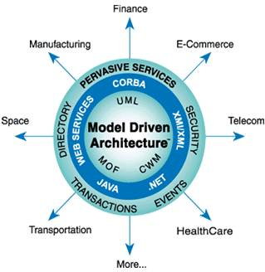
Model driven architecture(MDA)
Model-Driven Architecture (MDA) is a framework for software development processes that is at the core of the Object Management Group's (OMG) recommendations:

Slide 71
Model driven architecture(MDA)
There are three models in MDA:
CIM = Computation-Independent Model PIM = Platform-Independent Model PSM = Platform-Specific Model
The CIM combines the requirements and domain models. It models the system in terms of how it will interact with its environment.
The PIM is the design model. It describes the internal structure of the model without regard to the hosting platform.
The PSM is the implementation model. It adds concepts from the hosting platform to the hosting platform.

Slide 72
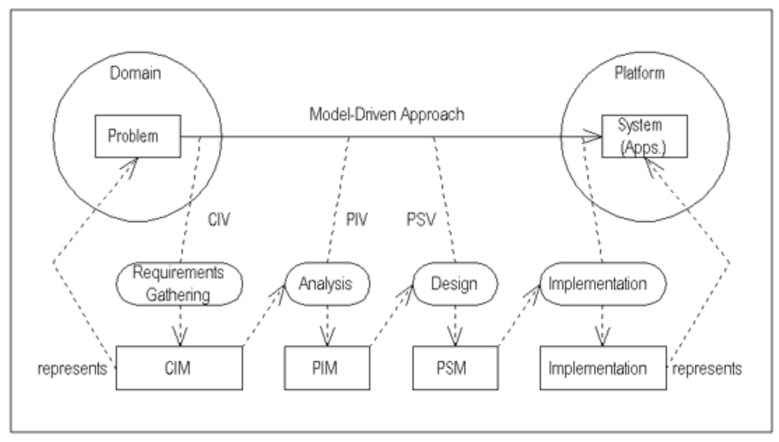
Foundational concepts of MDA

Slide 73
Model driven architecture(MDA)
System ,models and model driven approaches:
A system (or physical system) is a collection of elements organized together for a specific purpose.
A model of a system is a description or specification of the system and its environment for a specific purpose.
A model-driven approach focus on models to work with systems, including understating, designing, constructing, deploying, operating, maintaining, and modifying them.

Slide 74
Model driven architecture(MDA)
Platforms, Applications, and Implementations:
A platform is a set of technologies, including functionality provided through interfaces and usage patterns.
An application refers to some functionality provided by a system.
An implementation is a specification that contains all of the information for construing and putting a system into operation.

Slide 75
Model driven architecture(MDA)
Architecture, Viewpoints, Views, and Models:
The architecture of a system involves what elements make up the system and how they work together to provide the functionality of the system.
A viewpoint on a system involves a perspective focusing on specific concerns regarding the system.
A view (or viewpoint model) of a system is a representation of the system from the perspective of a viewpoint.

Slide 76
UML structure
The structural diagrams represent the static aspect of the system.
The four structural diagrams are −
Class diagram
Object diagram
Component diagram
Deployment diagram

Slide 77
Class diagram
Class diagrams are the most common diagrams used in UML.
Class diagram consists of classes, interfaces, associations, and collaboration.
Class diagrams basically represent the object-oriented view of a system, which is static in nature.

Slide 78
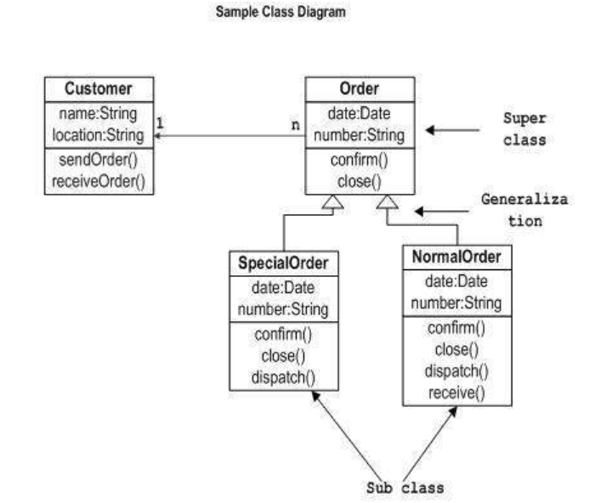

Slide 79
Object diagrams
Object diagrams can be described as an instance of class diagram.
Object diagrams are a set of objects and their relationship is just like class diagrams.
They also represent the static view of the system.
The usage of object diagrams is similar to class diagrams but they are used to build prototype of a system from a practical perspective.

Slide 80
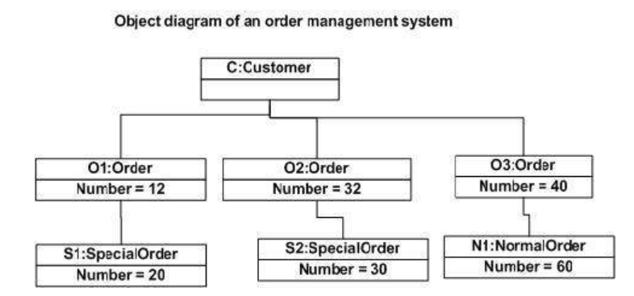

Slide 81
Component diagram
Component diagrams represent a set of components and their relationships.
These components consist of classes, interfaces, or collaborations. Component diagrams represent the implementation view of a system.
Component diagrams represent the implementation view of a system.
Finally, it can be said component diagrams are used to visualize the implementation.
Component diagram cannot be matched directly with other UML diagrams discussed so far as it is drawn for completely different purpose.

Slide 82
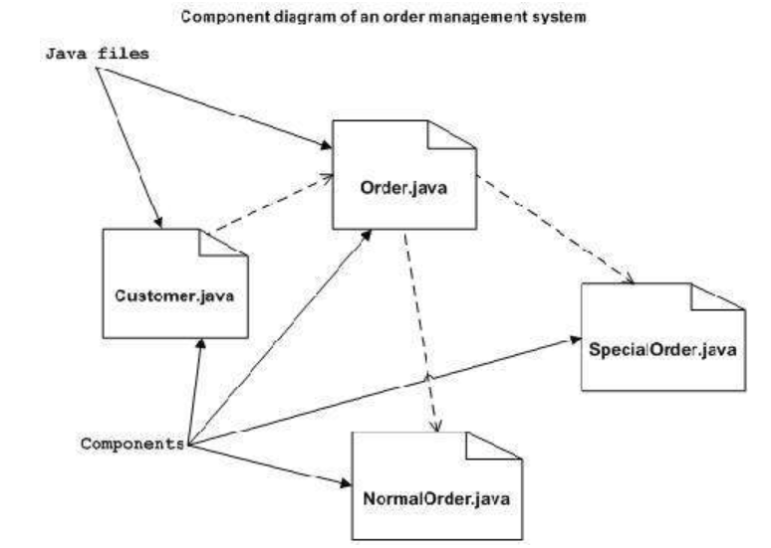

Slide 83
Deployment diagrams
Deployment diagrams are a set of nodes and their relationships.
These nodes are physical entities where the components are deployed.
Deployment diagrams are used for visualizing the deployment view of a system.
This is generally used by the deployment team.

Slide 84
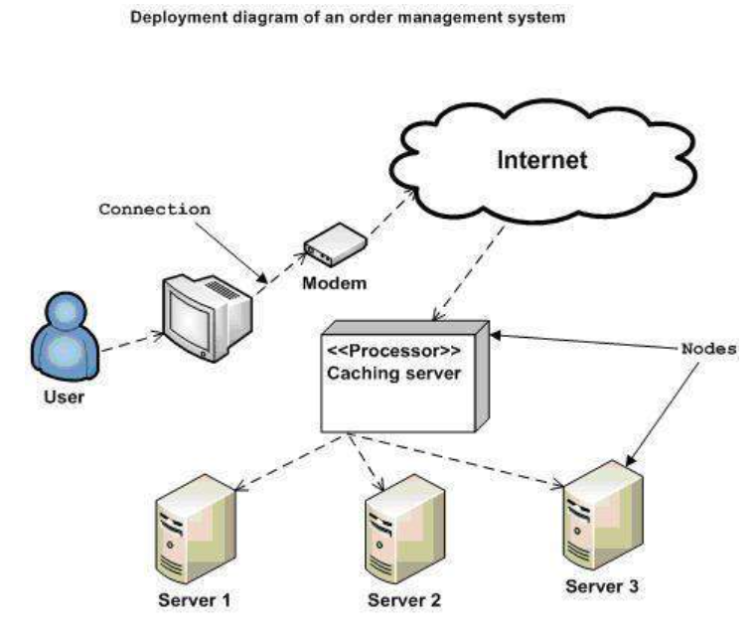

Slide 85
UML building blocks
Building blocks generate one complete UML model diagram by rotating around several different blocks.
It plays an essential role in developing UML diagrams. The basic UML building blocks are enlisted below:
Things
Relationships
Diagrams

Slide 86
UML building blocks
Things
Anything that is a real world entity or object is termed as things.
It can be divided into several different categories:
Structural things
Behavioral things
Grouping things
Annotational things

Slide 87
UML building blocks
Structural things
Nouns that depicts the static behavior of a model is termed as structural things.
They display the physical and conceptual components.
They include class, object, interface, node, collaboration, component, and a use case.

Slide 88
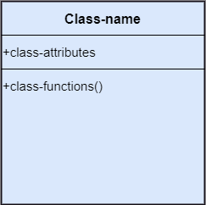
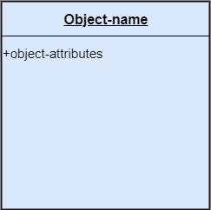
UML building blocks
Class: A Class is a set of identical things that outlines the functionality and properties of an object.
Object:: An individual that describes the behavior and the functions of a system.

Slide 89

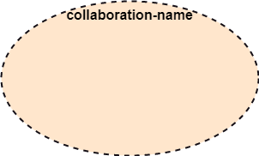
UML building blocks
Interface: A set of operations that describes the functionality of a class, which is implemented whenever an interface is implemented.
Collaboration: It represents the interaction between things that is done to meet the goal. It is symbolized as a dotted ellipse with its name written inside it.

Slide 90
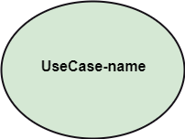
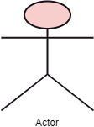
UML building blocks
Use case: Use case is the core concept of object-oriented modeling. It portrays a set of actions executed by a system to achieve the goal.
Actor: It comes under the use case diagrams. It is an object that interacts with the system, for example, a user.

Slide 91
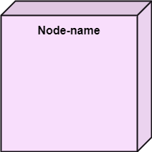
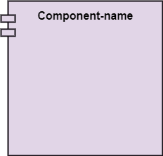
UML building blocks
Component: It represents the physical part of the system.
Node: A physical element that exists at run time.

Slide 92
UML building blocks
Behavioral Things
They are the verbs that encompass the dynamic parts of a model.
It depicts the behavior of a system.
They involve state machine, activity diagram, interaction diagram, grouping things, annotation things.

Slide 93
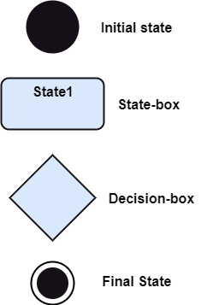
UML building blocks
State Machine:
It defines a sequence of states that an entity goes
through in the software development lifecycle.

Slide 94
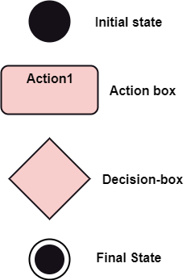
UML building blocks
Activity Diagram:
It portrays all the activities accomplished by different entities of a system.
It is represented the same as that of a state machine diagram.

Slide 95
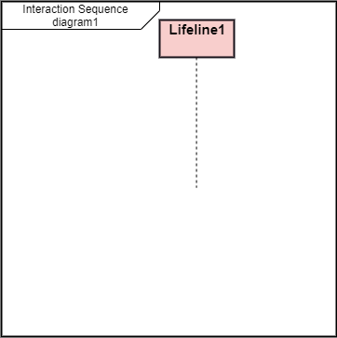
UML building blocks
Interaction Diagram: It is used to envision the flow of messages between several components in a system.

Slide 96
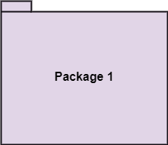
UML building blocks
Grouping Things
It is a method that together binds the elements of the UML model.
In UML, the package is the only thing, which is used for grouping.
Package: Package is the only thing that is available for grouping behavioral and structural things.

Slide 97
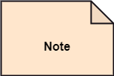
UML building blocks
Annotation Things
It is a mechanism that captures the remarks, descriptions, and comments of UML model elements.
In UML, a note is the only Annotational thing.
Note: It is used to attach the constraints, comments, and rules to the elements of the model.
It is a kind of yellow sticky note.

Slide 98
Relationships
It illustrates the meaningful connections between things.
It shows the association between the entities and defines the functionality of an application.
There are four types of relationships given below:
1.Dependency:
Dependency is a kind of relationship in which a change in target element affects the source element, or simply we can say the source element is dependent on the target element.

Slide 99
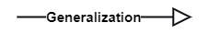
Relationships
2.Association:
-A set of links that associates the entities to the UML model.
-It tells how many elements are actually taking part in forming that relationship.
3. Generalization:
-It portrays the relationship between a general thing (a parent class or superclass) and a specific kind of that thing (a child class or subclass).

Slide 100
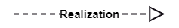
Relationships
4.Realization:
It is a semantic kind of relationship between two things, where one defines the behavior to be carried out, and the other one implements the mentioned behavior.
It exists in interfaces.

Slide 101
UML common mechanism
It can be classified in to:
Specifications
Adornments
Common Divisions
Extensibility Mechanisms

Slide 102
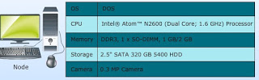
UML common mechanism
Specification:
Specification provides a textual statement describing interesting aspects of a system.

Slide 103
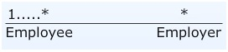
UML common mechanism
Adornments :
Textual/graphical items added to the basic notation of an element.
They are used for explicit visual representation of those aspects of an element that are beyond the most important
Examples: The basic notation of association is line, but this could be adorned with additional details, such as the role names and multiplicity of each end.

Slide 104
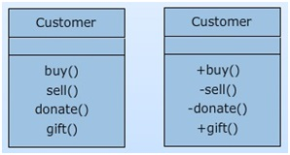
UML common mechanism
Similarly, a class notation may highlight most important aspects of a class, i.e., name, attributes and operations.
To show access specifies for the attributes and methods of a class adornments such as +, -, # are used.

Slide 105
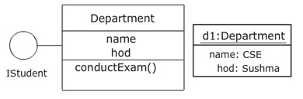
UML common mechanism
Common division:
In modeling, object-oriented systems get divided in multiple ways.
For example, class vs. object, interface vs. implementation
An object uses the same symbol as its class with its name underlined

Slide 106
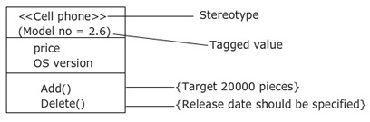
UML common mechanism
Extensibility Mechanisms:
Extensibility mechanisms allow extending the language in controlled ways.
They include Sterotypes, Tagged Values and Constraints.

Slide 107
UML common mechanism
Extensibility mechanisms can be classified in to:
Stereotypes
Tagged Values
Constraints

Slide 108
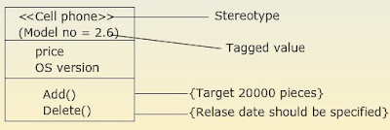
UML common mechanism
Stereotypes:
Stereotypes are used to create new building blocks from existing blocks
New building blocks are domain-specific
Stereotypes are used to extend the vocabulary of a system
Graphically represented as a name enclosed by guillemets (« »)

Slide 109
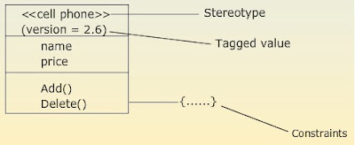
UML common mechanism
Tagged Values :
Tagged values are used to add to the information of the element (not of its instances)
Stereotypes help to create new building blocks, whereas tagged values help to create new attributes
These are commonly used to specify information relevant to code generation, configuration management and so on

Slide 110
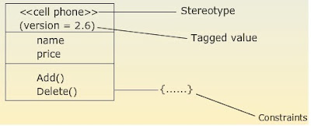
UML common mechanism
Constraints :
Constraints are used to create rules for the model
Rules that impact the behavior of the model, and specify conditions that must be met
Can apply to any element in the model, i.e., attributes of a class, relationship
Graphically represented as a string enclosed by braces {....} and placed near the associated elements or connected to that elements by dependency relationships

Slide 111
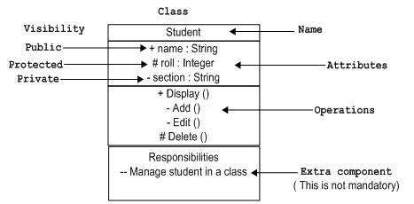
UML diagram notational techniques
Class notation:

Slide 112
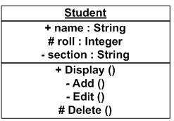
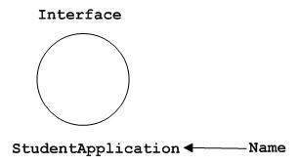
UML diagram notational techniques
Object notation: Interface notation

Slide 113
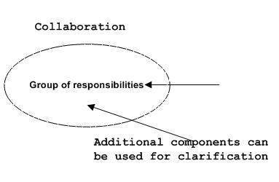
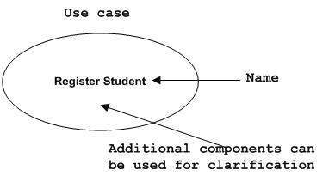
UML diagram notational techniques
Collaboration notation: Use Case Notation

Slide 114
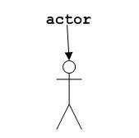
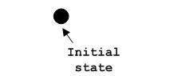
UML diagram notational techniques
Actor notation: Initial State Notation

Slide 115
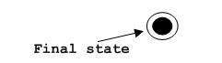
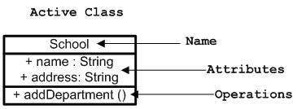
UML diagram notational techniques
Final State Notation Active Class Notation

Slide 116
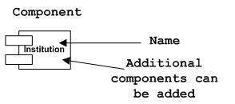
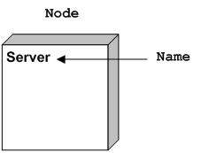
UML diagram notational techniques
Component Notation Node Notation

Slide 117
4+1 view
The 4+1 View Model was designed by Philippe Kruchten.
It is a multiple view model that addresses different features and concerns of the system.
It is an architecture verification method for studying and documenting software architecture design.

Slide 118
4+1 view
It provides four essential views −
The logical view or conceptual view − It describes the object model of the design.
The process view − It describes the activities of the system, captures the concurrency and synchronization aspects of the design.
The physical view − It describes the mapping of software onto hardware and reflects its distributed aspect.
The development view − It describes the static organization or structure of the software in its development of environment.

Slide 119
4+1 view
This view model can be extended by adding one more view called scenario view or use case view for end-users or customers of software systems.
It is coherent with other four views and are utilized to illustrate the architecture serving as “plus one” view, (4+1) view model.
Why it is a 4+1 view?
The use case view has a special significance as it details the high level requirement of a system while other views details — how those requirements are realized.
When all other four views are completed, it’s effectively redundant.
That means there is a 5th view but is a invisible.

Slide 120
